Slide 1
SQL Performance
CHƯƠNG TRÌNH ĐÀO TẠO NHÂN VIÊN
MÔN HỌC: SQL
HANOI – NOV, 2015

Slide 2
What is Index?
A structure provides rapid access to table rows based on the values of one or more columns.
Notes:
One of the physical storage structures that is provided by most SQL-based database
management systems is an index, which is a structure that provides rapid access to the
rows of a table based on the values of one or more columns.

Slide 3
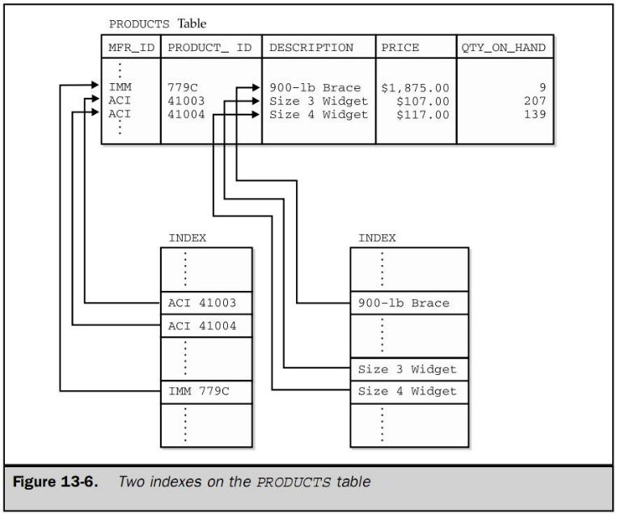
Notes:
One of the indexes provides access based on the DESCRIPTION column. The other provides access based
on the primary key of the table, which is a combination of the MFR_ID and PRODUCT_ID columns.

Slide 4
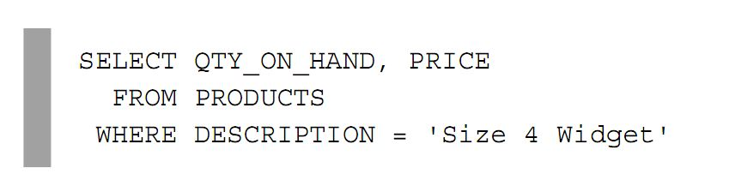
How index work?

Slide 5
Without Index?
If no index for DESCRIPTION column, DBMS scan all rows of PRODUCTS table, row by row.
Large table with thousands or millions of rows, the scan could take minutes or hours.
Notes:
If there were no index for the DESCRIPTION column, the DBMS would be forced to
process the query by sequentially scanning the PRODUCTS table, row by row, examining
the DESCRIPTION column in each row. To make sure it had found all of the rows that
satisfied the search condition, it would have to examine every row in the table. For a
large table with thousands or millions of rows, the scan of the table could take minutes
or hours.

Slide 6
With Index?
Stores data values and pointers to the rows
Data values are arranged in Asc or Desc order so DBMS can search quickly
Follow the pointer to locate the row
Completely transparent to SQL user
Notes:
The index stores data values and pointers to the rows where those data values occur. In the index the data values
are arranged in ascending or descending order, so that the DBMS can quickly search
the index to find a particular value. It can then follow the pointer to locate the row
containing the value.
The presence or absence of an index is completely transparent to the SQL user who
accesses a table.
With an index for the DESCRIPTION column, the DBMS can locate the requested
data with much less effort. It searches the index to find the requested value (“Size 4
widget”) and then follows the pointer to find the requested row(s) of the table.

Slide 7
Why Index fast?
The index is sorted and its rows (data+pointer) are very small.
Moving from index to row(s) is also very rapid
Notes:
The index search is very rapid because the index is sorted and its rows are very small.
Moving from the index to the row(s) is also very rapid because the index tells the
DBMS where on the disk the row(s) are located.

Slide 8
How fast is Index?
non-unique: N blocks access
unique: Linear Search – N/2 blocks access
Sorted: Binary Search – Log₂N blocks access
Notes:
The index search is very rapid because the index is sorted and its rows are very small.
Moving from the index to the row(s) is also very rapid because the index tells the
DBMS where on the disk the row(s) are located.

Slide 9
Do an exercise!
block size B = 1,024 bytes
Record number = 5,000,000 records
Record length = 204 bytes
Block size = 1,024 bytes
(1,024/204) = 5 records/blocks
N = (5,000,000/5) = 1,000,000 blocks
N/2 = 500,000 block access
Log₂N = 20 blocks access

Slide 10
Disadvantage of Index!
block size B = 1,024 bytes
Consumes additional disk space.
Index must be updated every time on INSERT and UPDATE statements
Notes:
One disadvantage of having an index is that it consumes additional disk
space. Another disadvantage is that the index must be updated every time a row is
added to the table and every time the indexed column is updated in an existing row.
This imposes additional overhead on INSERT and UPDATE statements for the table.

Slide 11
When use Index?
block size B = 1,024 bytes
For columns that are used frequently in search conditions.
Queries are more frequent than inserts and updates. (reads = 100x or 1000x writes)
The total records are large enough
Notes:
In general, it’s a good idea to create an index for columns that are used frequently
in search conditions. Indexing is also more appropriate when queries against a table
are more frequent than inserts and updates. Most DBMS products always establish an
index for the primary key of a table, because they anticipate that access to the table will
most frequently be via the primary key.

Slide 12
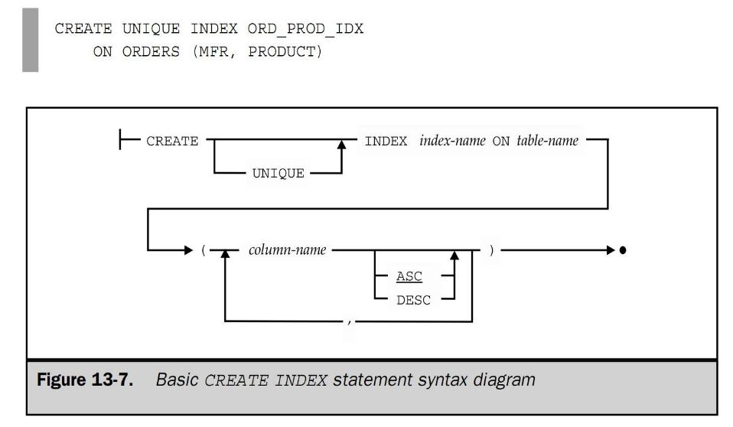
How to use Index?
block size B = 1,024 bytes

Slide 13
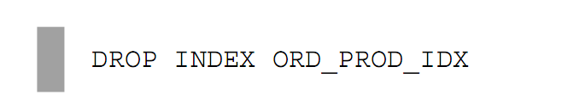
How to use Index?
block size B = 1,024 bytes

Slide 14
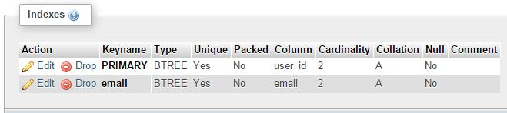
Fun Fact of Index ;)
block size B = 1,024 bytes
Most DBMS always establish an index for primary key and column defined with a uniqueness constraint
Notes:
Most DBMS products always establish an index for the primary key of a table, because they anticipate that access to the table will
most frequently be via the primary key.
Most DBMS products also automatically establish an index for any column (or
column combination) defined with a uniqueness constraint. The DBMS must check the
value of such a column in any new row to be inserted, or in any update to an existing
row, to make certain that the value does not duplicate a value already contained in the
table. Without an index on the column(s), the DBMS would have to sequentially search
through every row of the table to check the constraint. With an index, the DBMS can
simply use the index to find a row (if it exists) with the value in question, which is a
much faster operation than a sequential search.

Slide 15


Slide 16
THANK YOU!

